Slide 1

Automatic Polishing Machine
Author:
Marcos Martínez Roig
Institution:
Instituto de Física Corpuscular
E-mail:
Marcos.martinez@ific.uv.es

Slide 2
Index:
Polishing Machine
Pieces:
Axis system
Arduino and CNC Shield
GRBL language and Universal Gcode Sender
Drivers
Motors
Switch
Holding fiber piece
Holding polishing paper piece
Tests

Slide 3
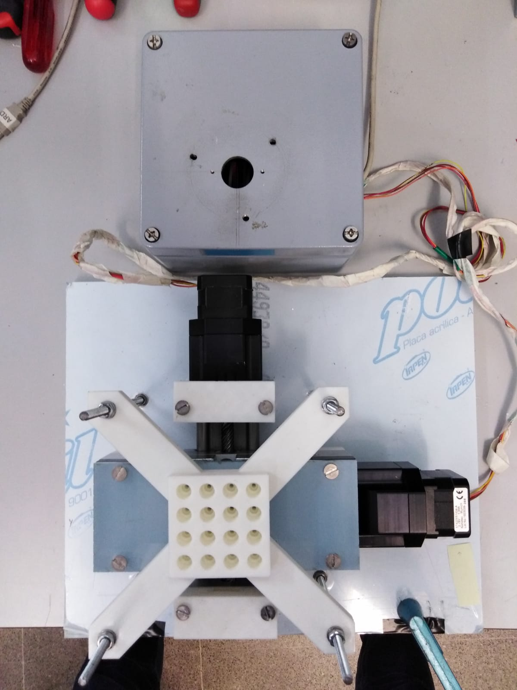
Polishing Machine
30 cm
16 cm
35 cm
16 cm

Slide 4
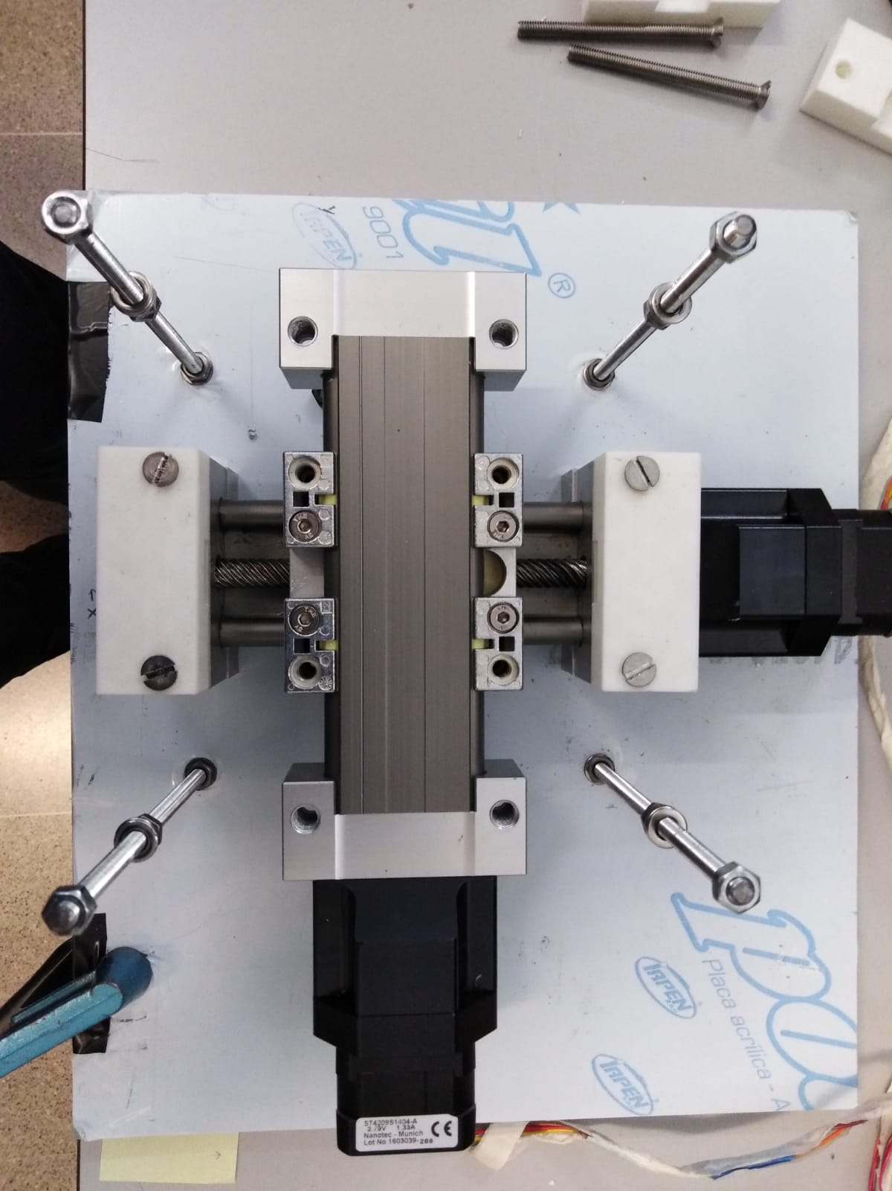
Axis system
Y axis
X axis

Slide 5
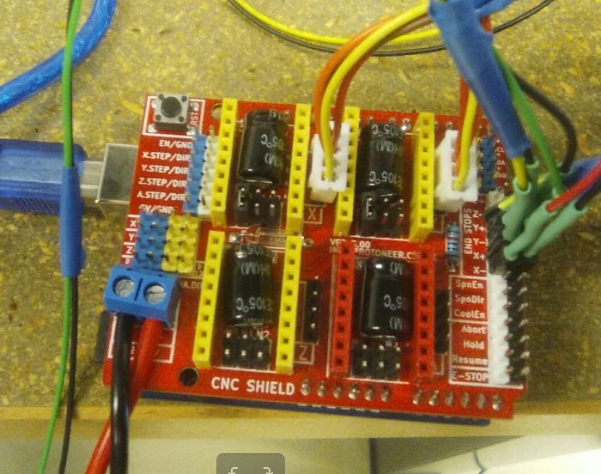
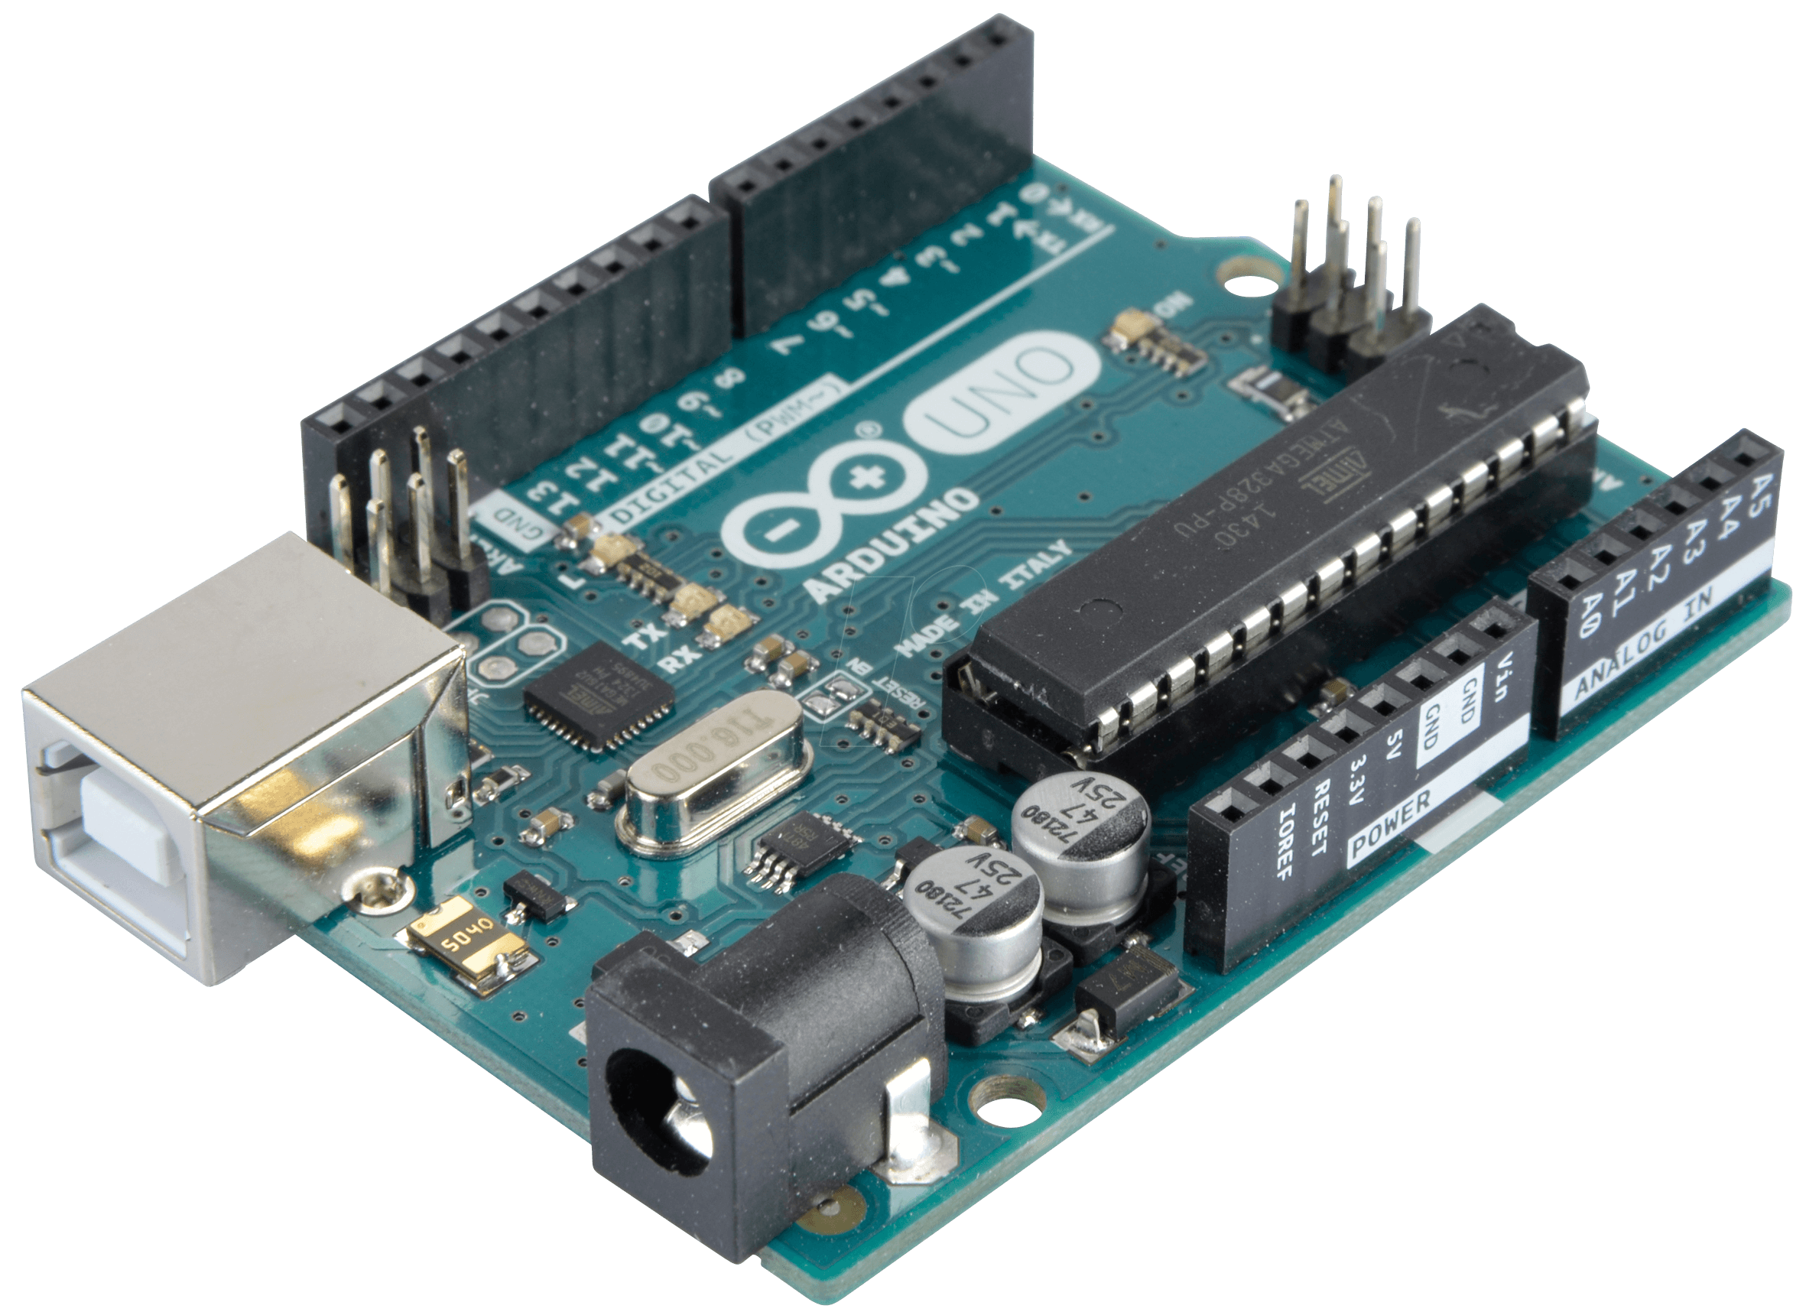
Arduino and CNC Shield

Slide 6
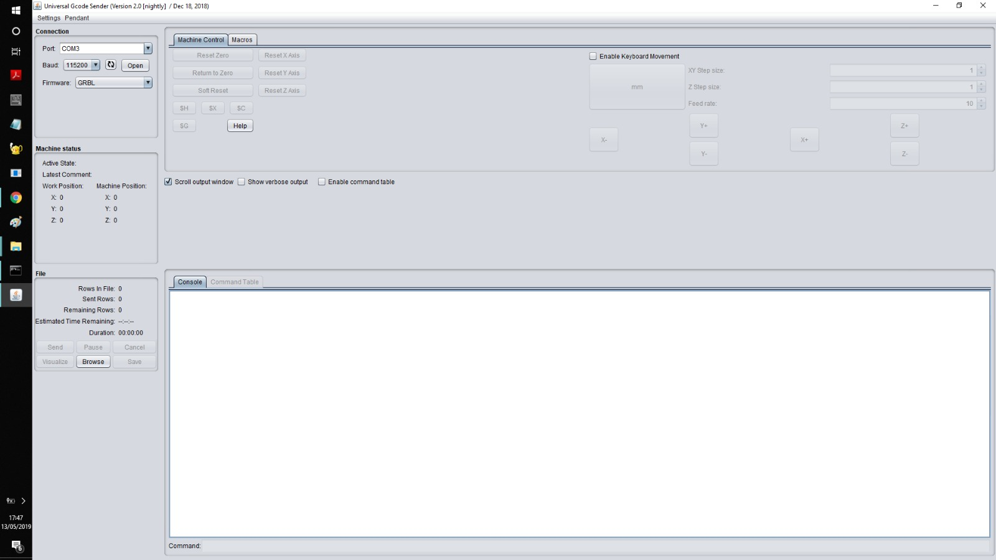
GRBL language and Universal Gcode Sender

Slide 7
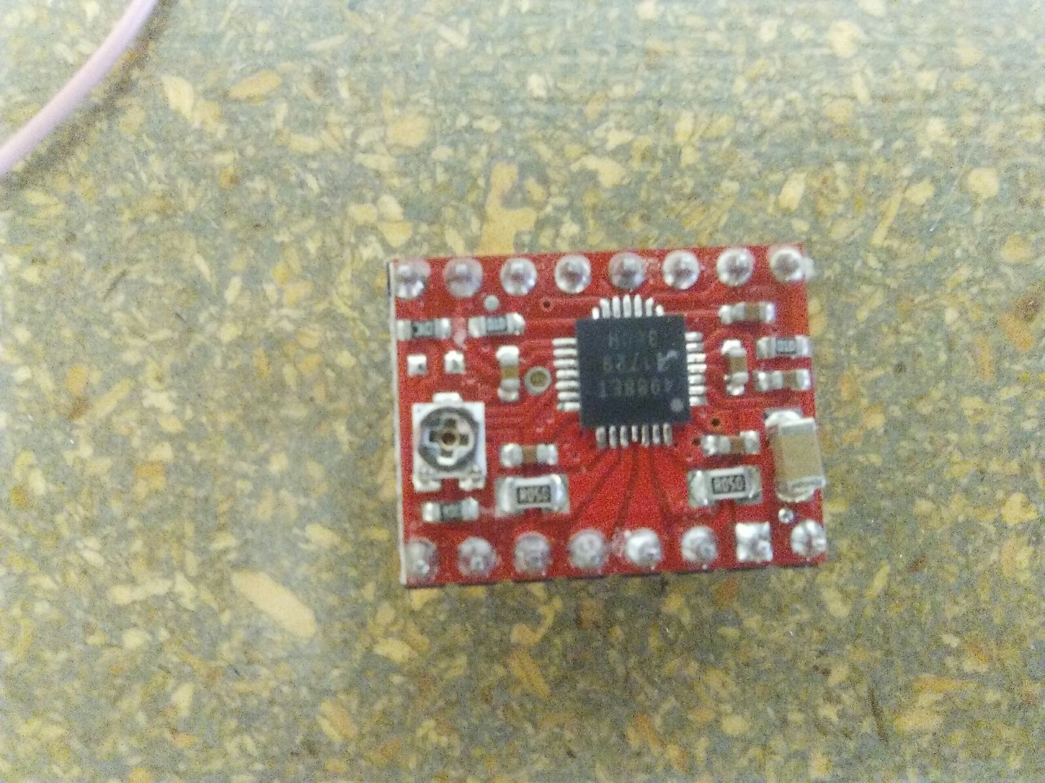
Drivers
Three different types:
A4988:

Slide 8
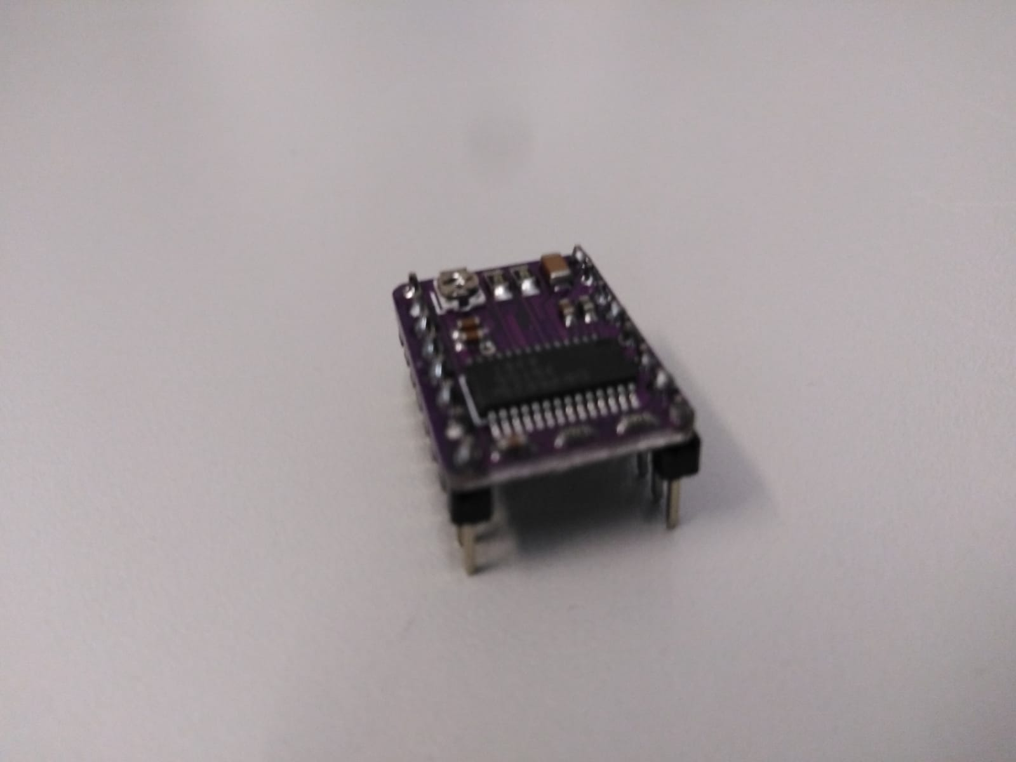
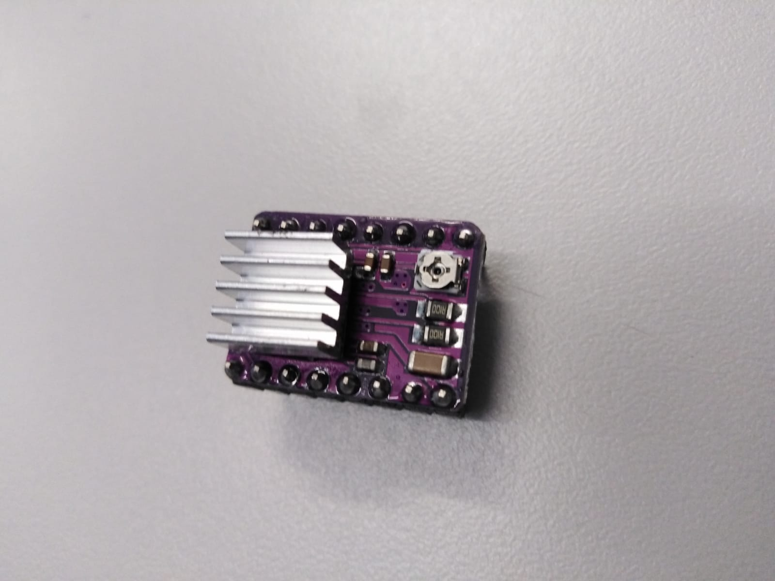
Drivers
Three different types:
A4988
DRV8825:

Slide 9
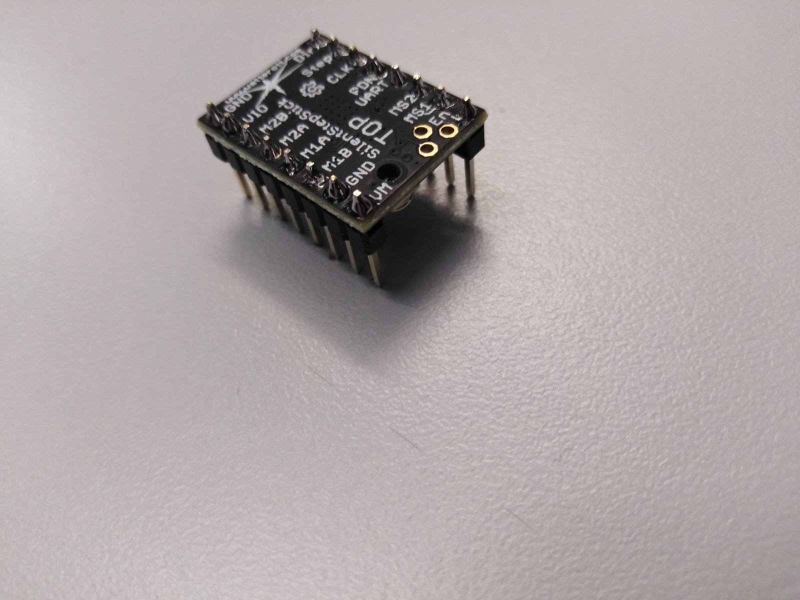
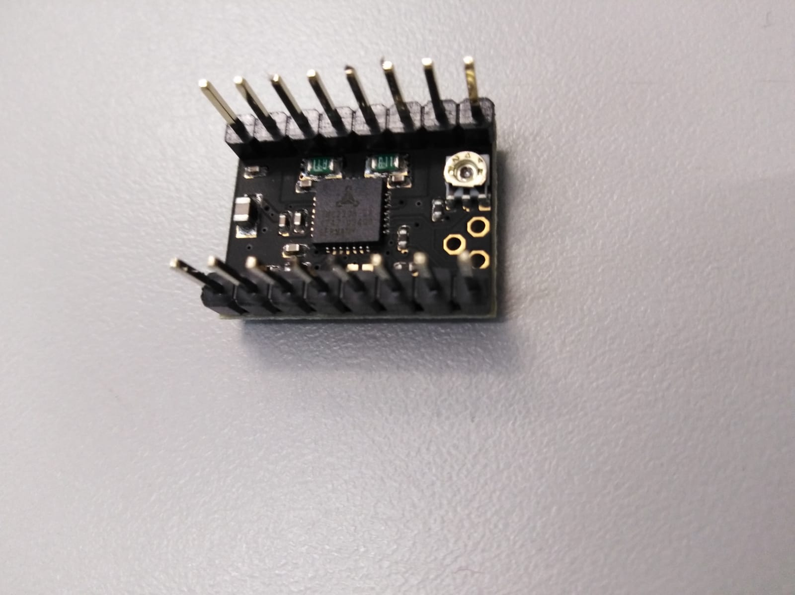
Drivers
Three different types:
A4988
DRV8825
TMC2208:

Slide 10
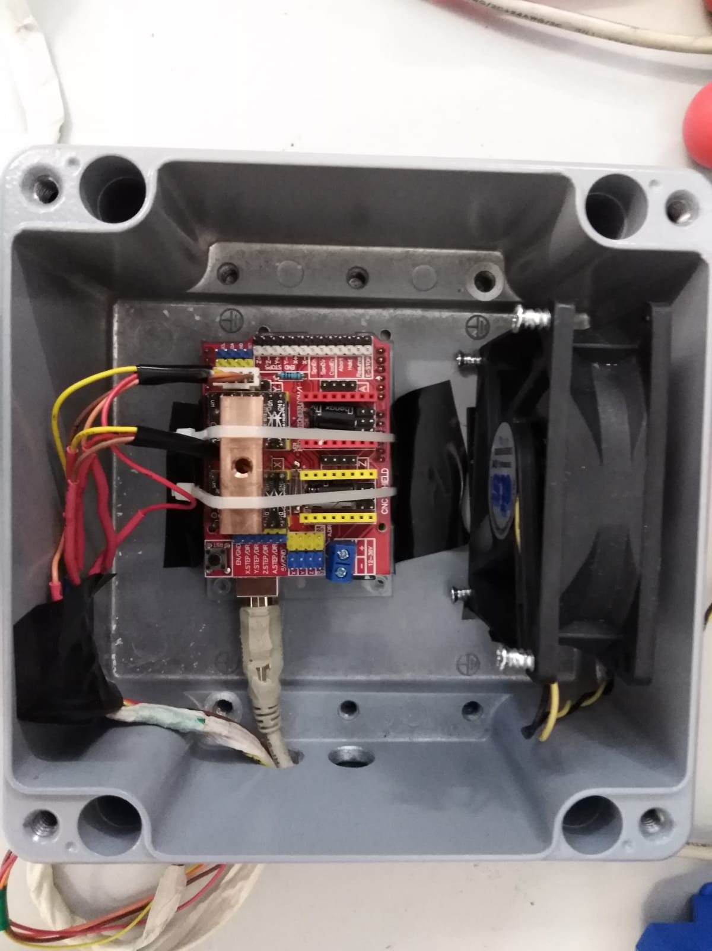
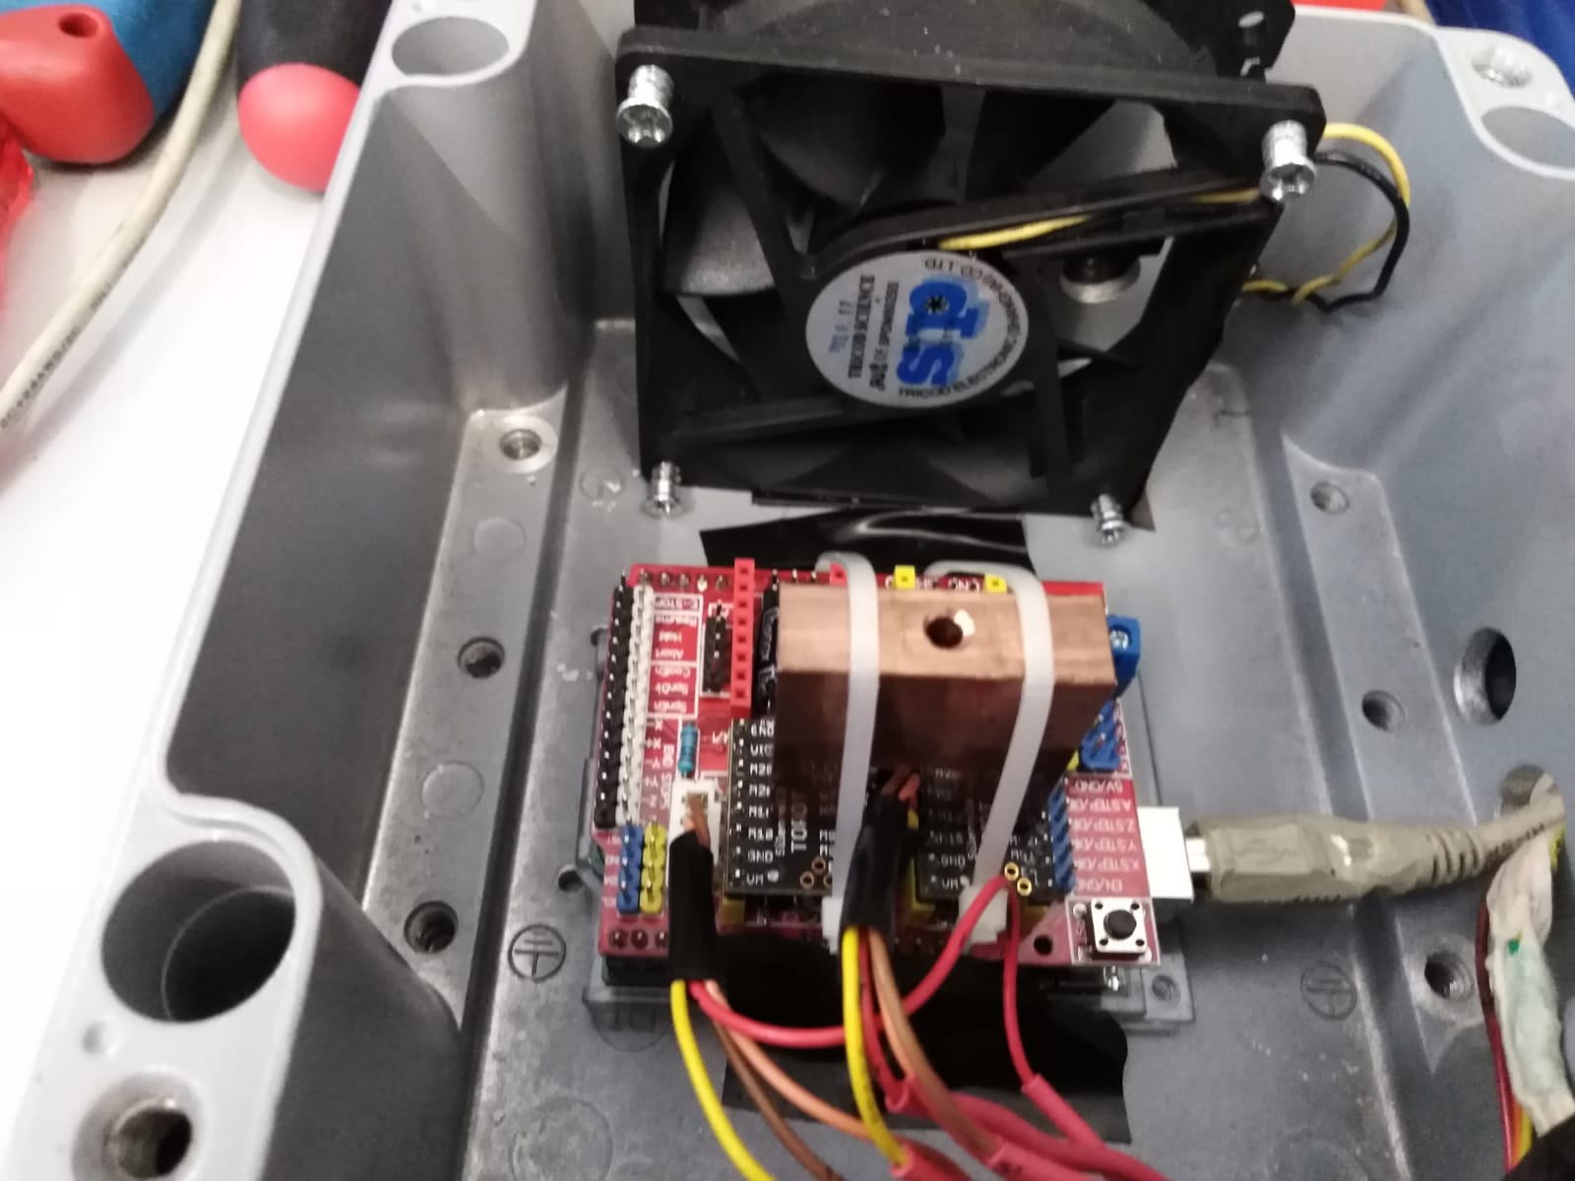
Metalic box
Copper piece
2,5 cm
5,7 cm
7,8 cm
16cm
8 cm
16 cm

Slide 11
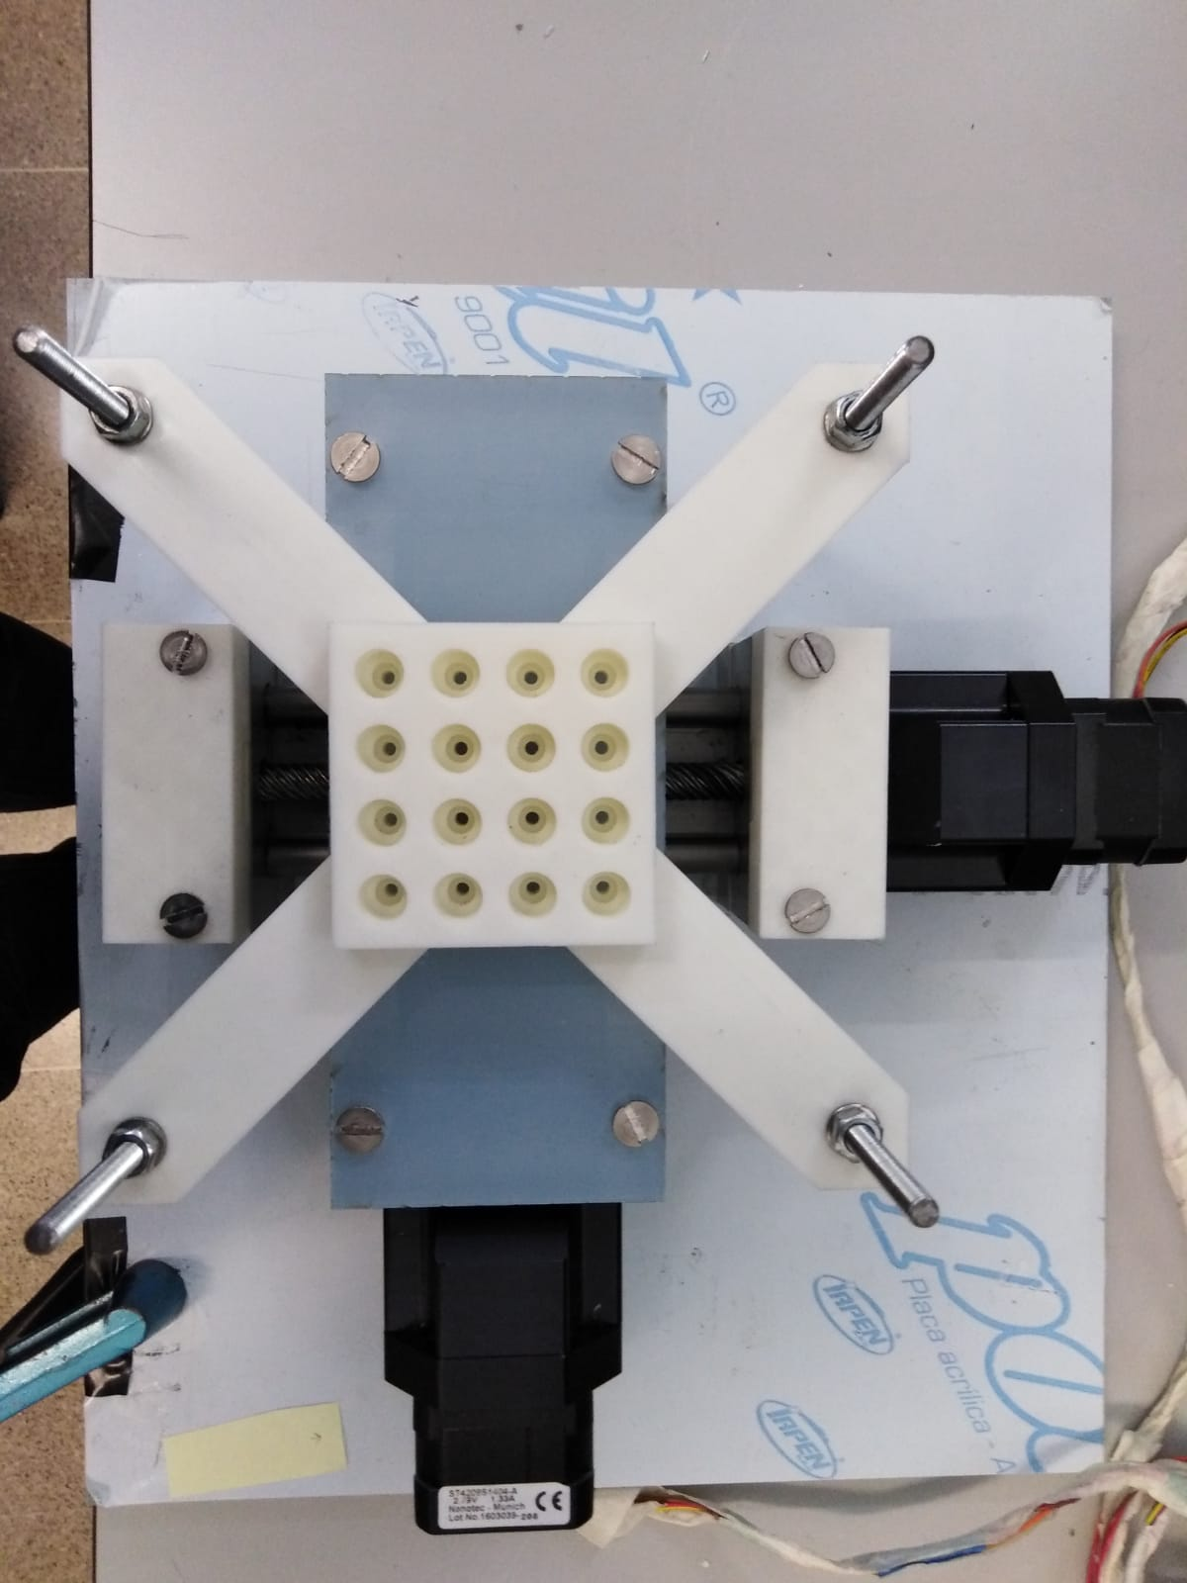
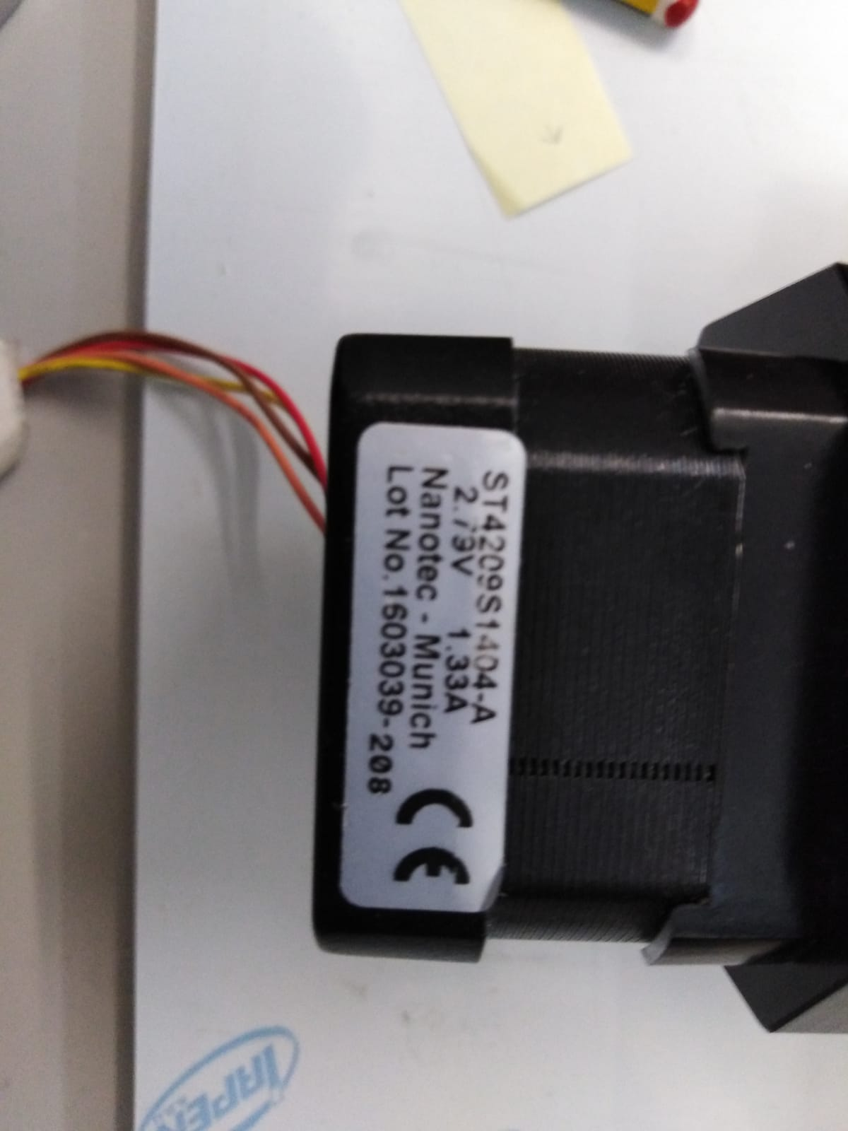
Motors
NEMA ST4209S1404A

Slide 12
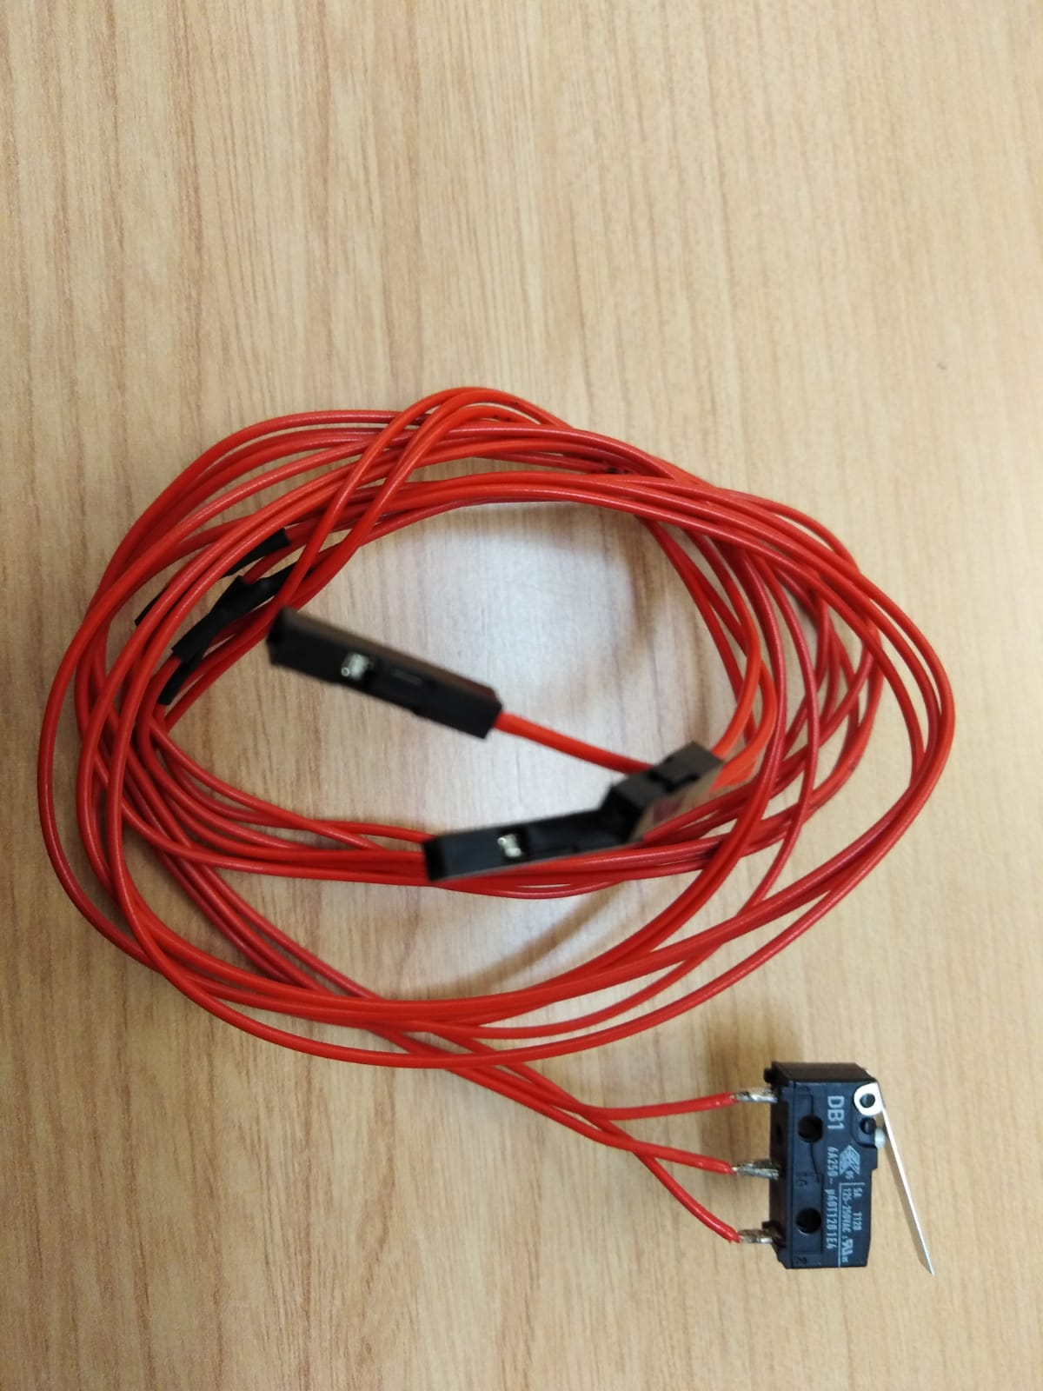
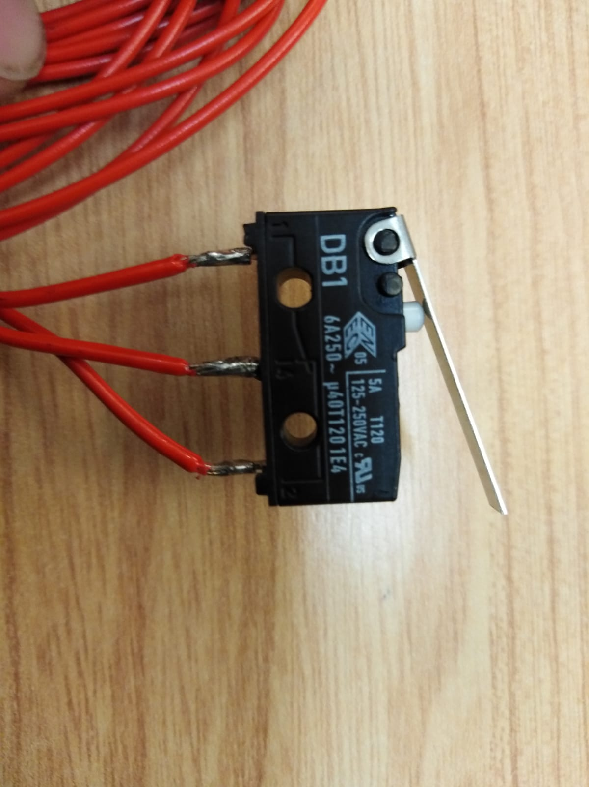
Switch

Slide 13
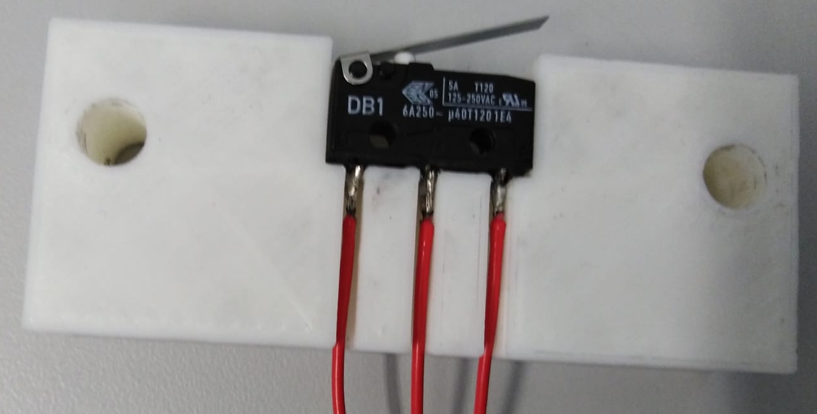
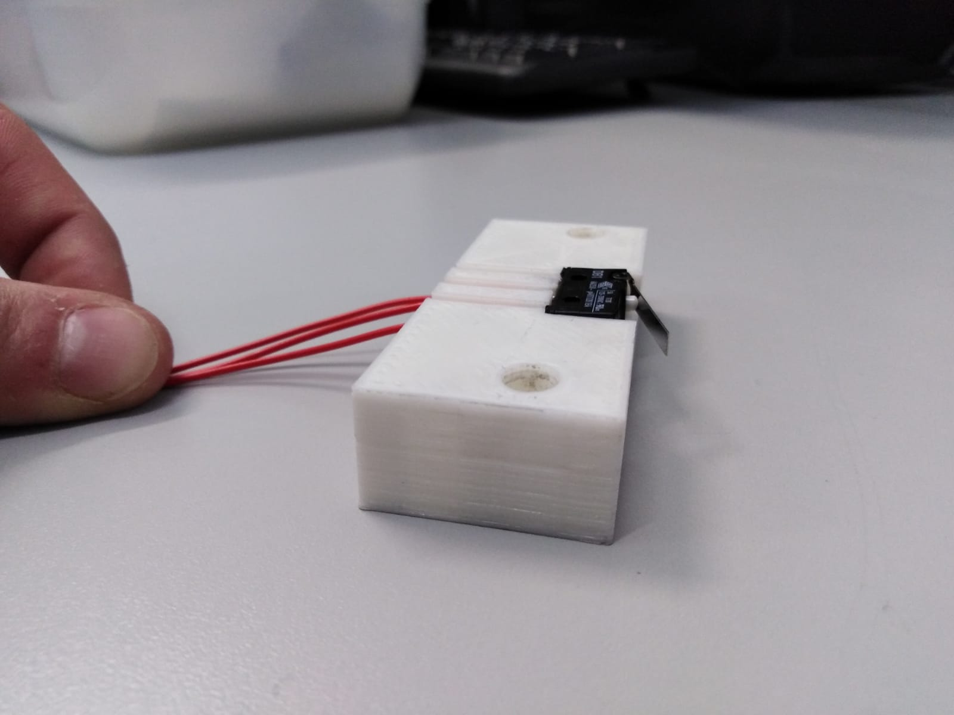
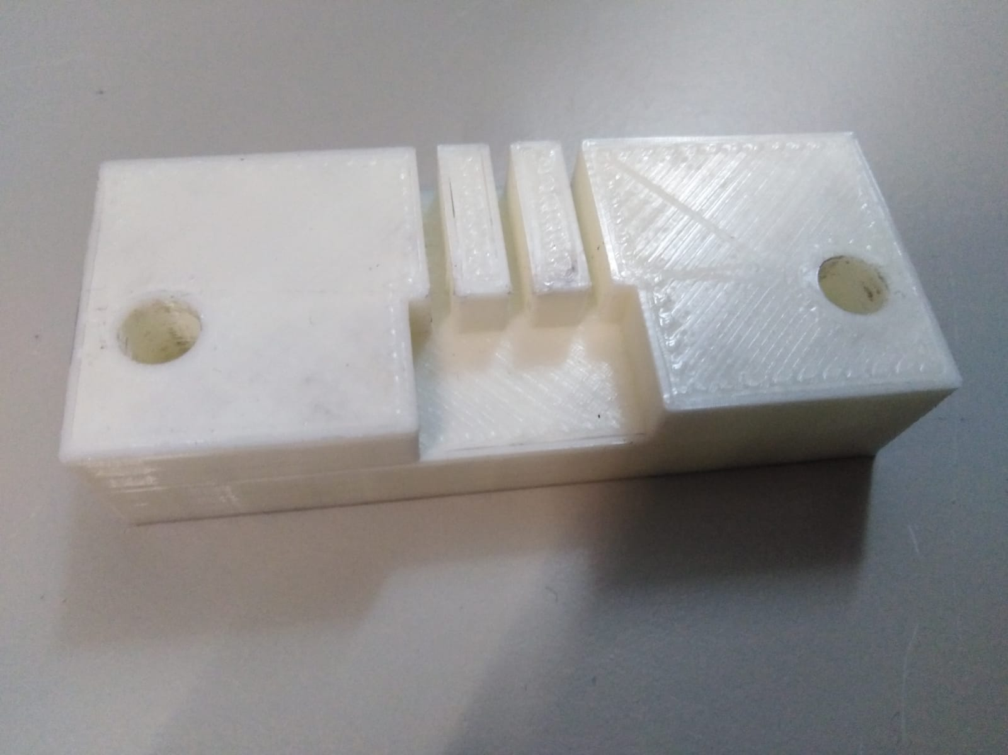
3D pieces for Switchs

Slide 14
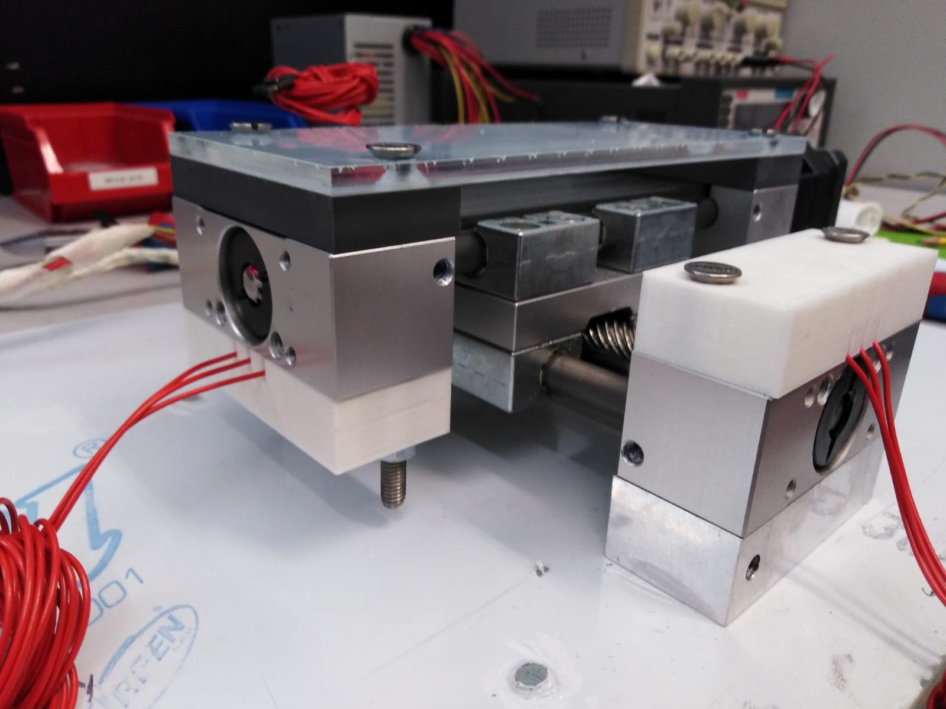
3D pieces for Switchs
Hard limits
Homing cycle

Slide 15
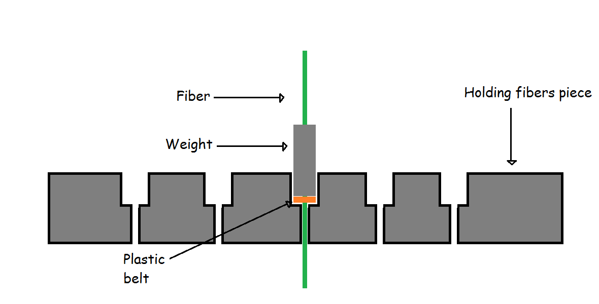
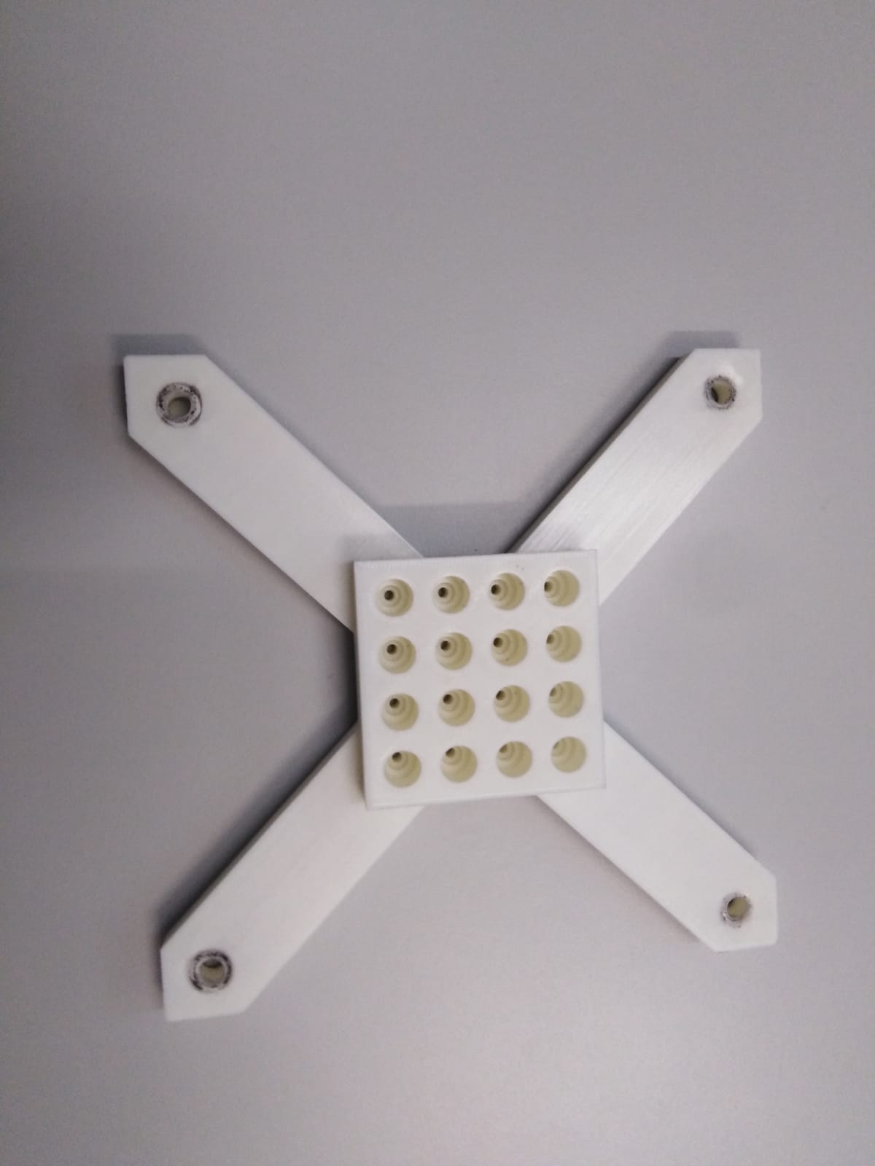
Holding fibber piece:
7 mm
20 mm

Slide 16
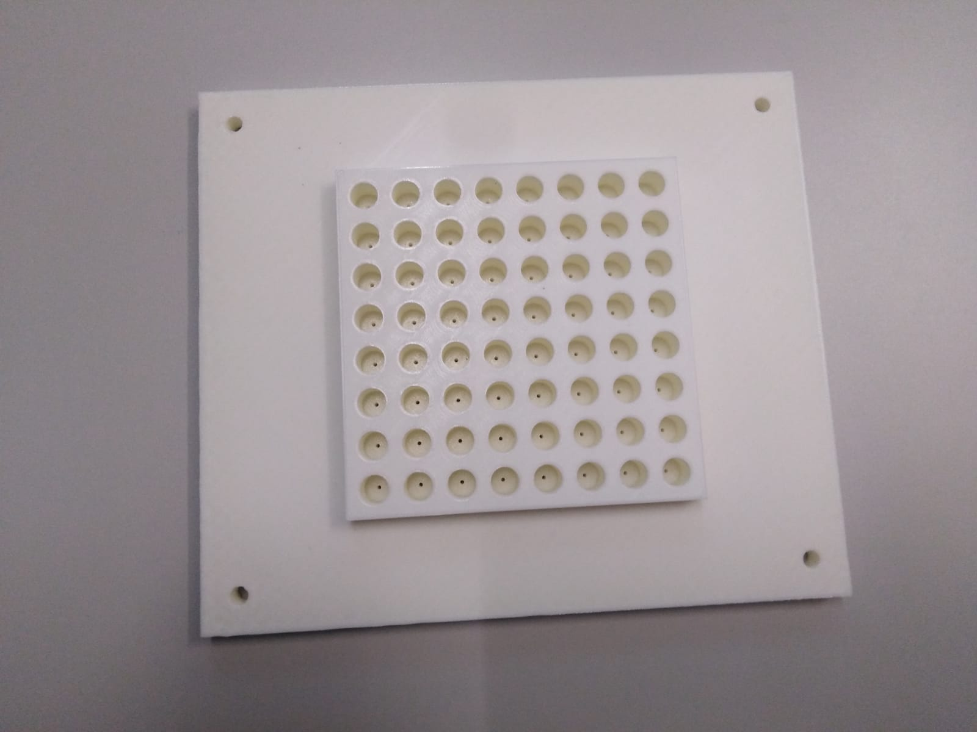
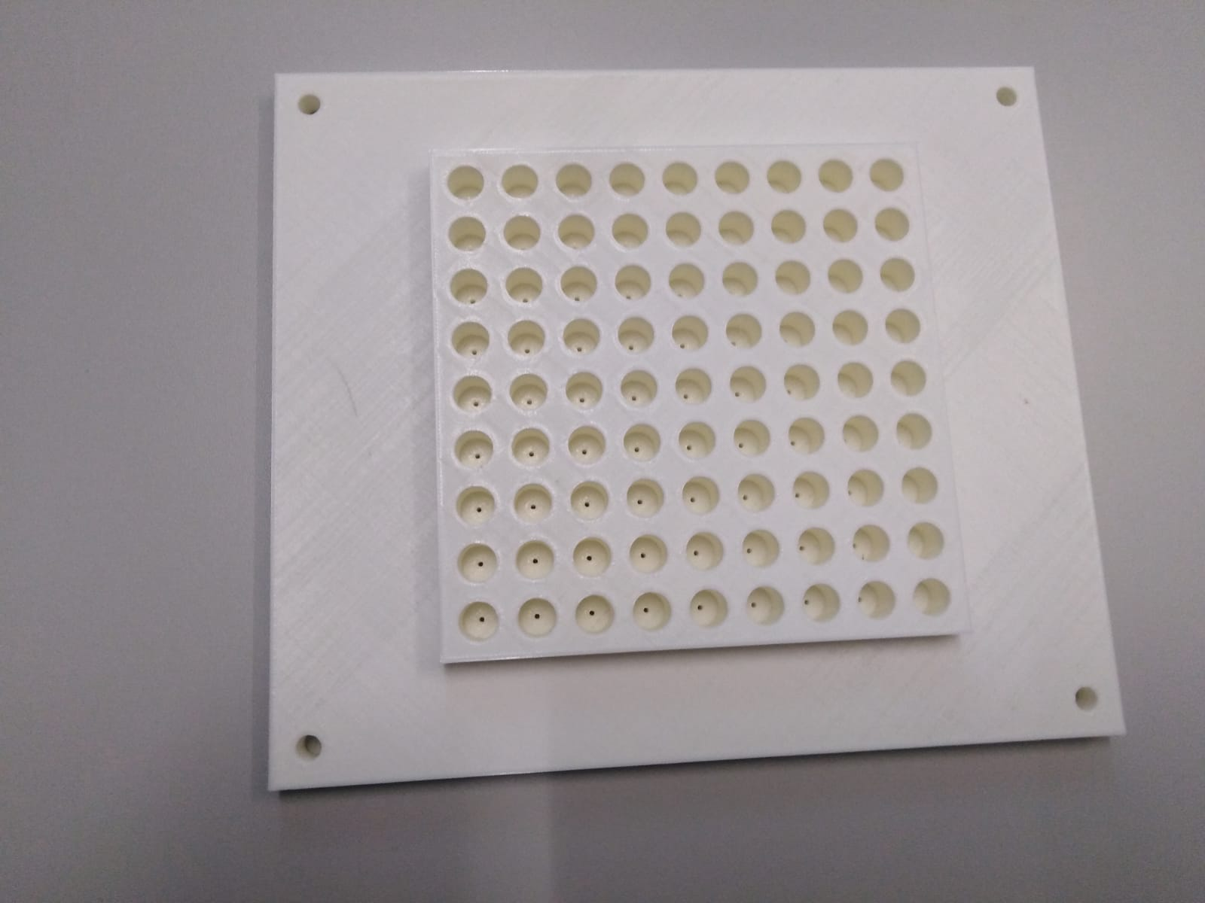
Holding fibber piece:
9 Holes
8 Holes
9 Holes
8 Holes

Slide 17
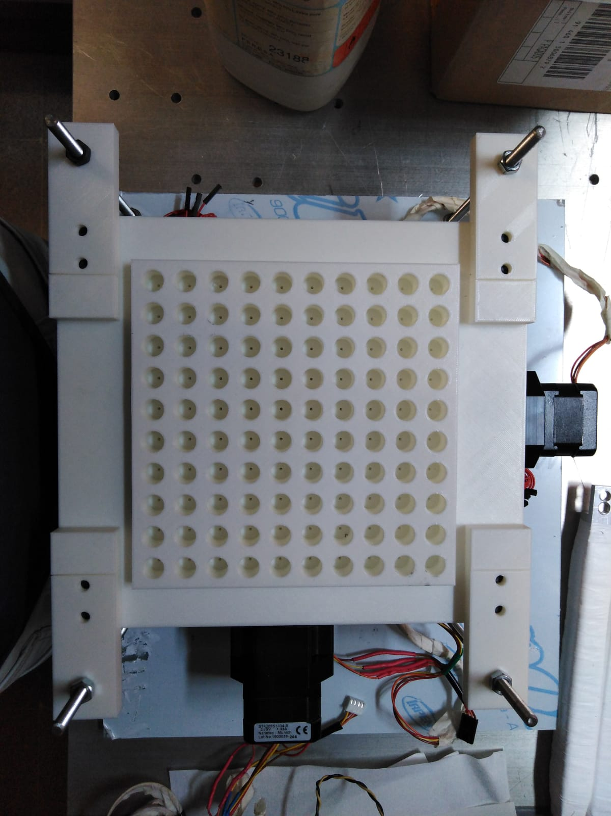
Holding fibber piece:
10 Holes
9 Holes
9 Holes
10 Holes

Slide 18
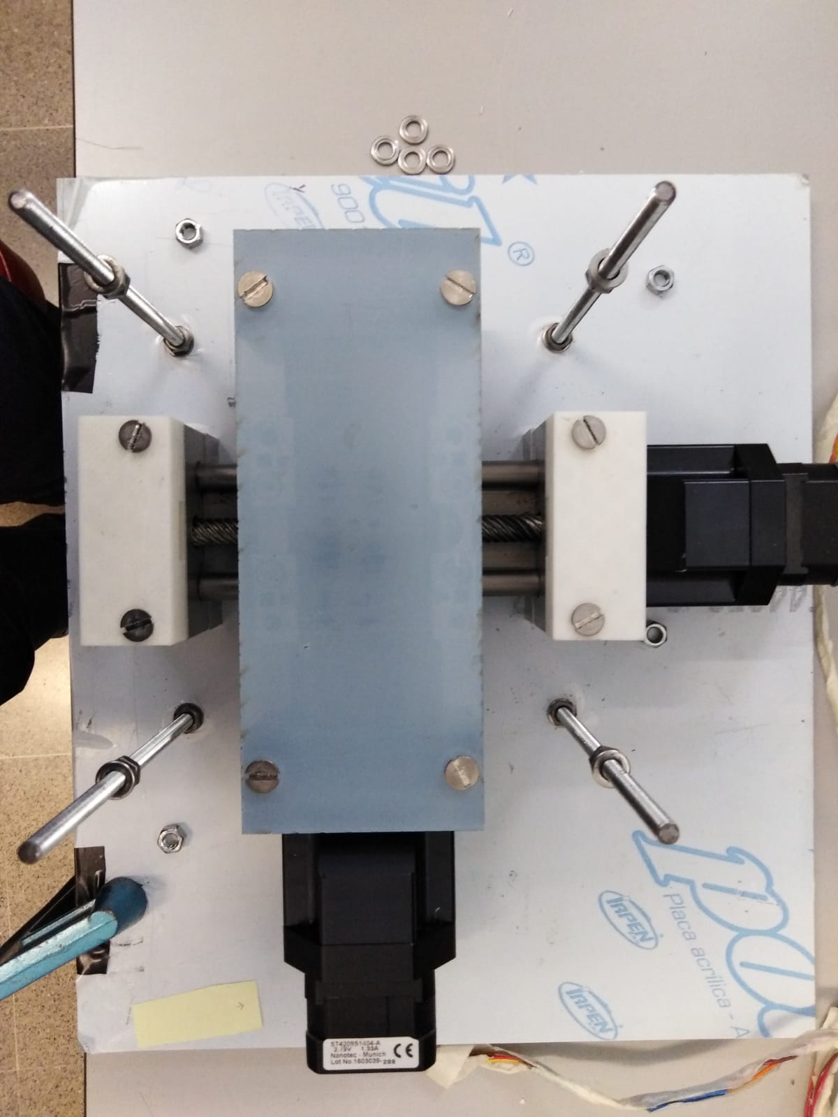
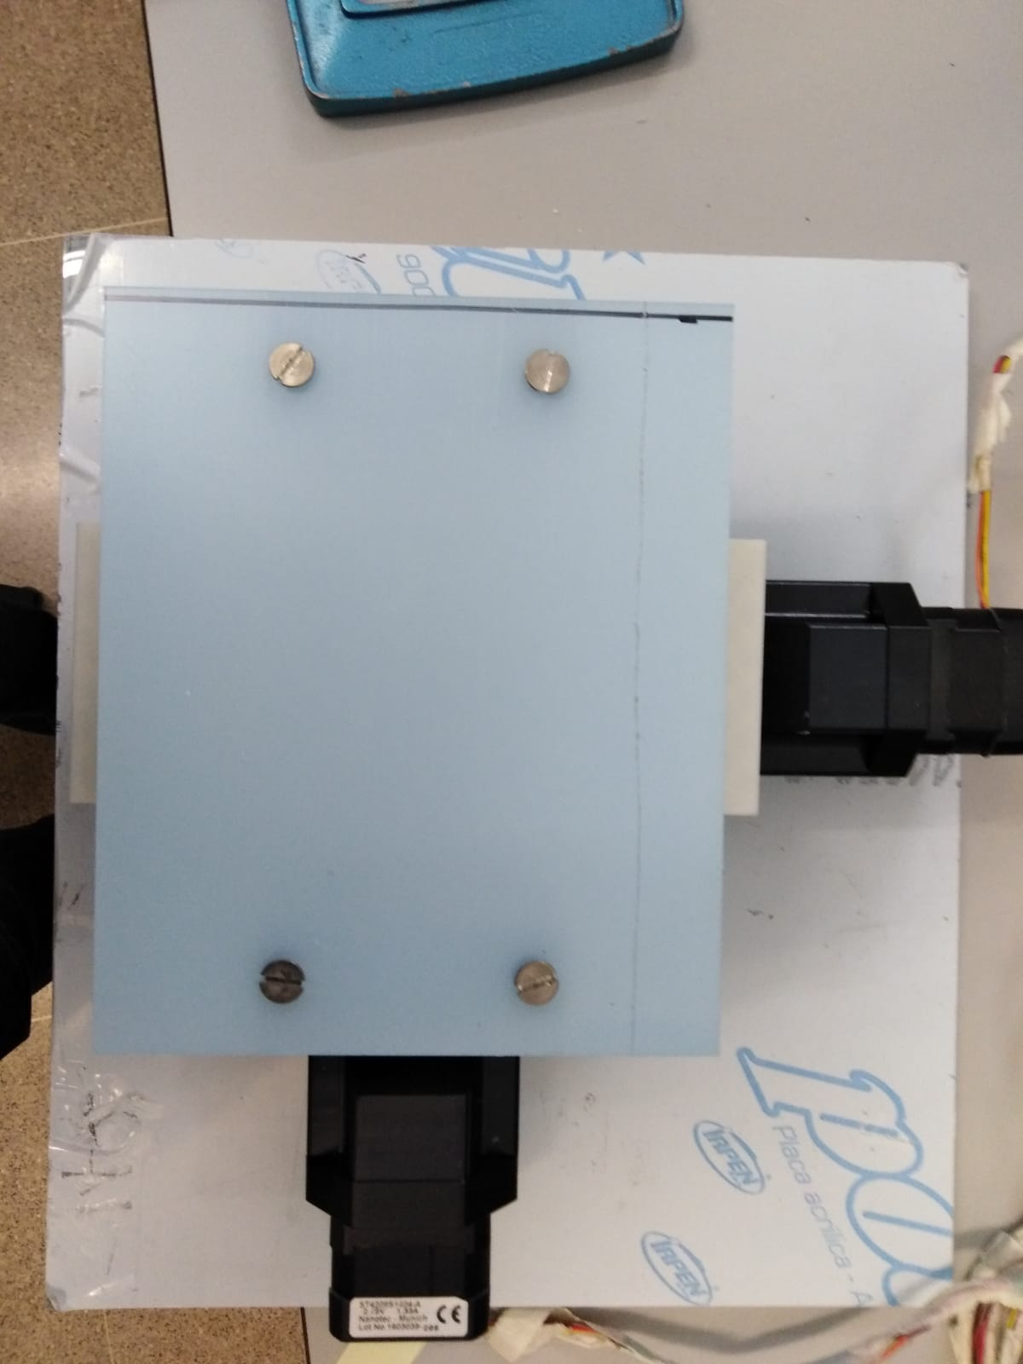
Holding polishing paper piece:

Slide 19
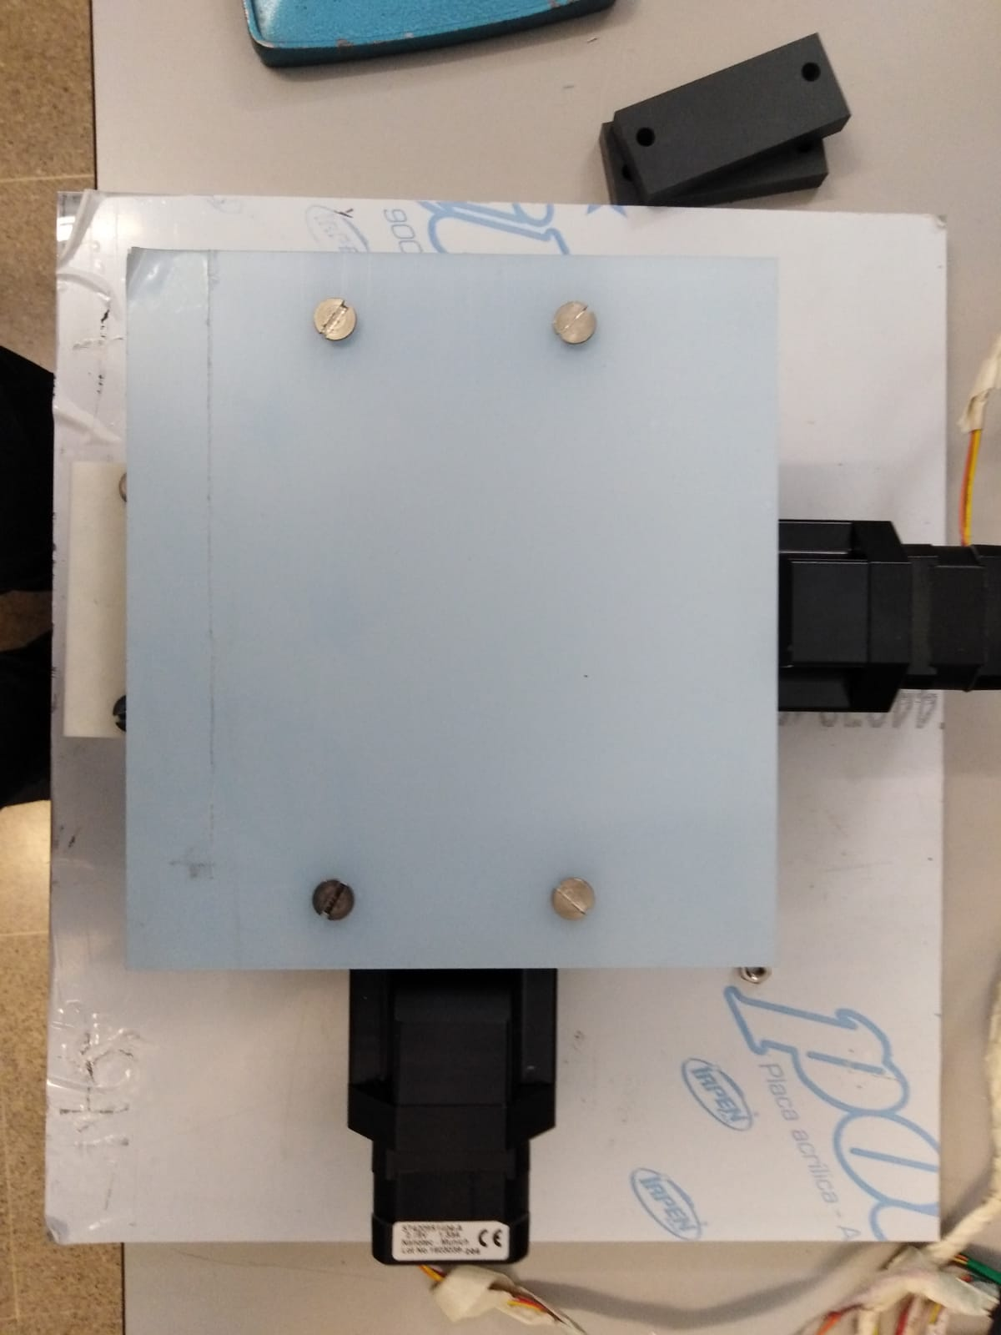
Holding polishing paper piece:

Slide 20
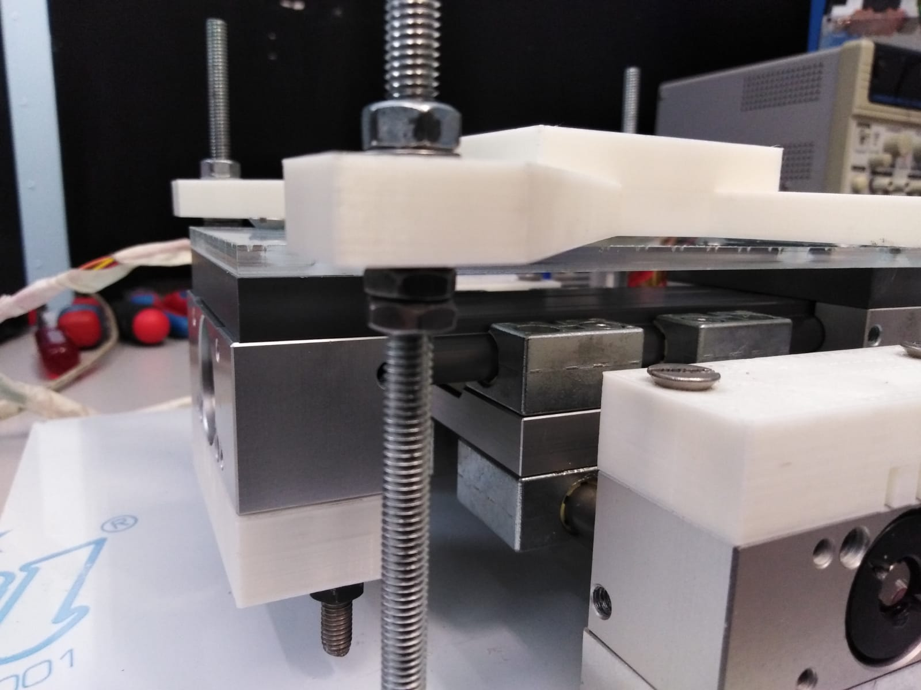
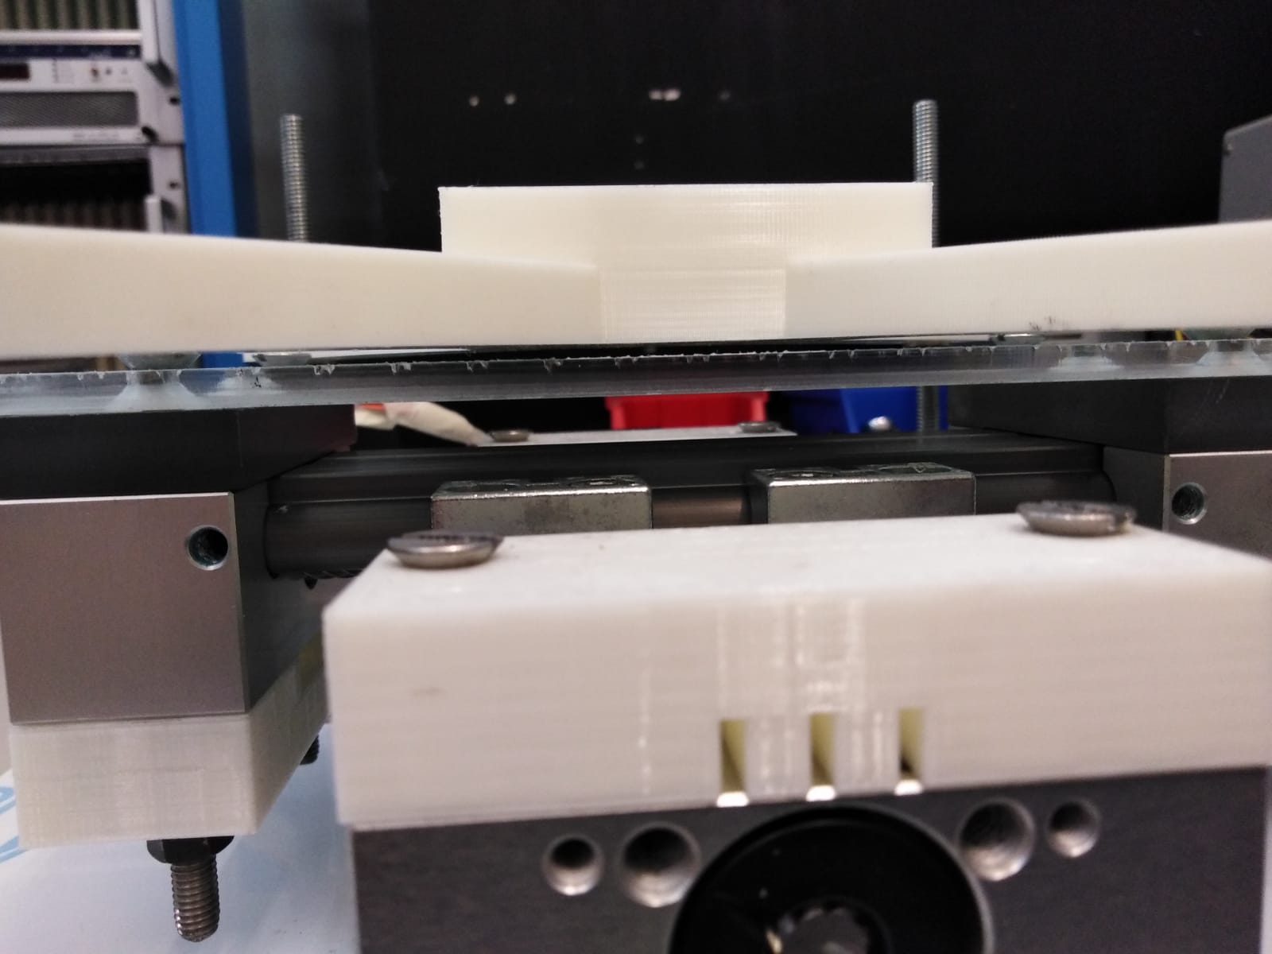
Holding fibber piece:

Slide 21
Tests

